Slide 1
Retail Wave
Unified Retail Logistics: Bridging the Gap between Online and In-Store Shopping

Slide 2
Problem

Slide 3
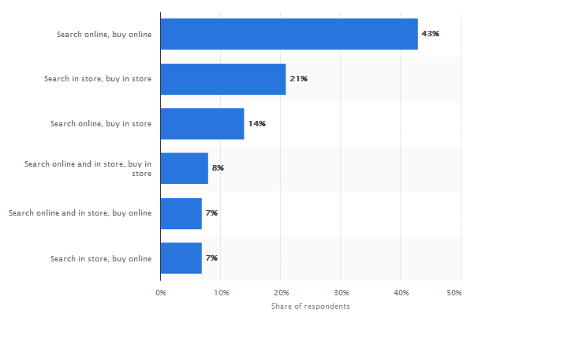

Slide 4
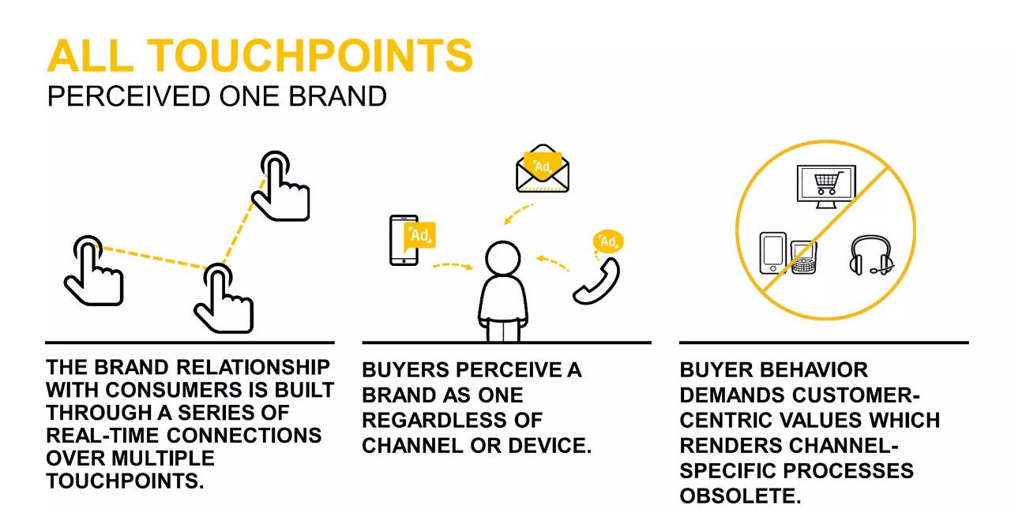

Slide 5
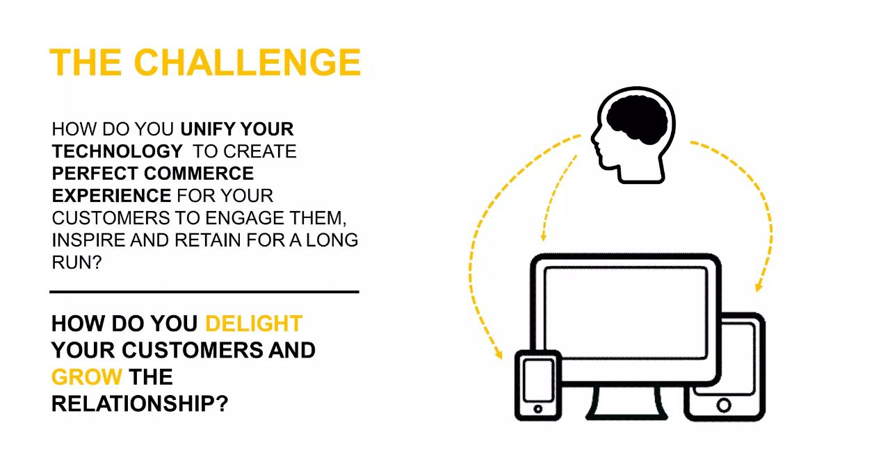

Slide 6
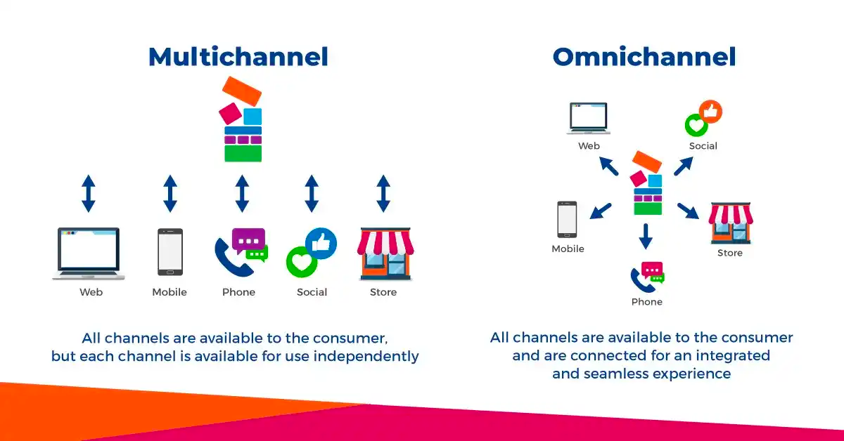
Solution:

Slide 7
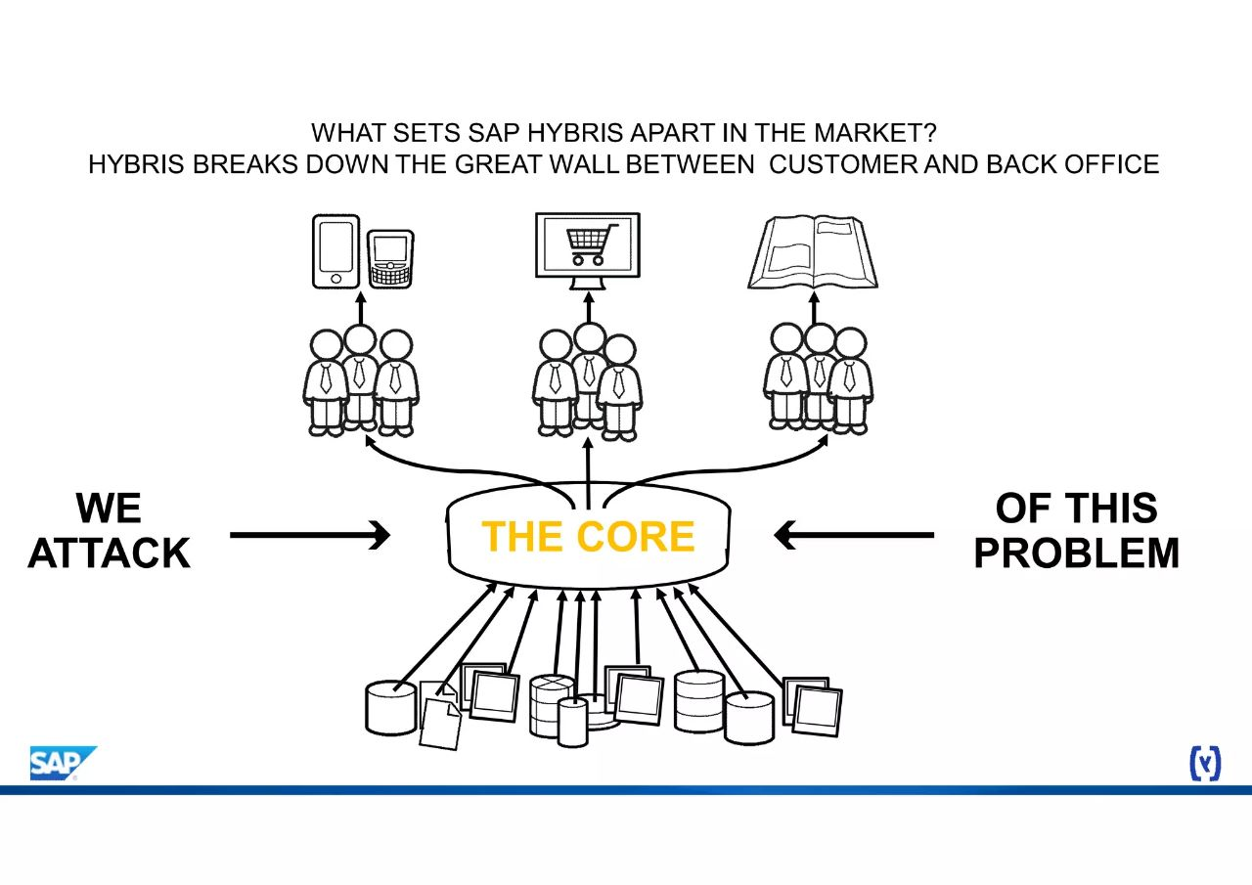

Slide 8
Target Audience
Retailers of all sizes looking to provide a modern and seamless shopping experience.
E-commerce businesses seeking to expand their online presence while maintaining physical stores.
Multiple Offline store chains who have presence in offline market but don’t have online presence.

Slide 9
Use Cases
Online-to-Offline (O2O) Conversion: A customer explores products on a retailer's website and then visits the physical store to try them before purchasing. Their online cart seamlessly transfers to the in-store POS for a convenient checkout process.
Buy Online, Pick Up In-Store (BOPIS): Shoppers buy products online and collect them in person. The solution ensures items are ready for pickup, streamlining the process for both customers and staff.
Cross-Channel Recommendations: Customers receive personalized product recommendations based on their online and offline shopping history, encouraging more purchases.

Slide 10
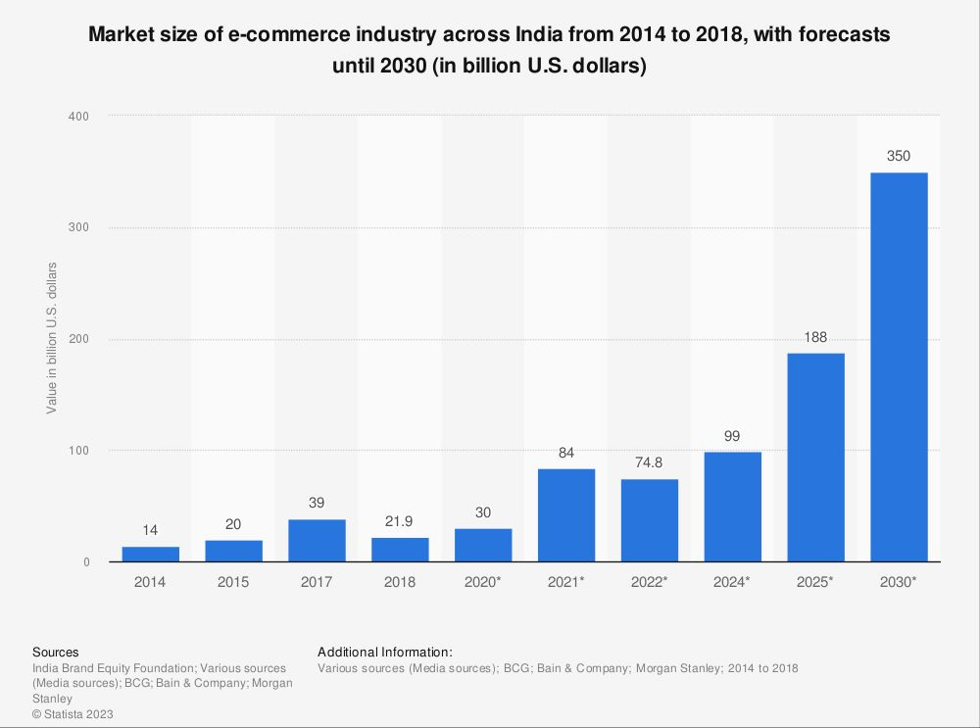

Slide 11
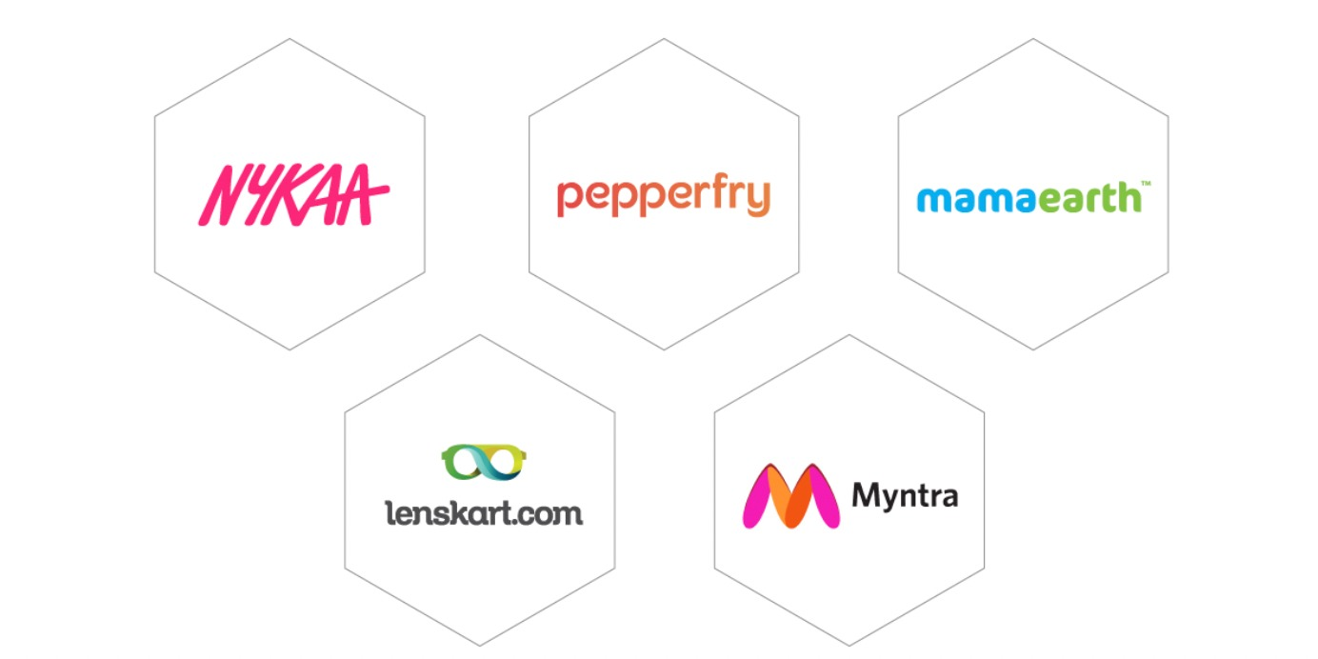
Big Brands who are using omnichannel:

